Slide 1
STEINER
TREE

Slide 2
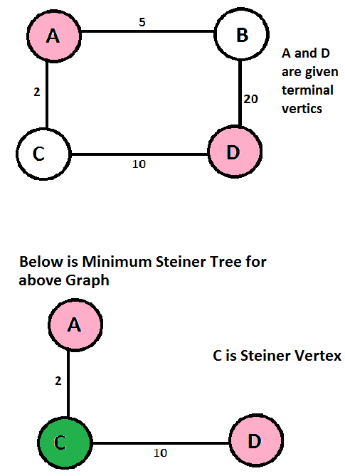
WHAT IS STEINER TREE?
Given a graph and a subset of vertices in the graph, a steiner tree spans though the given subset. The Steiner Tree may contain some vertices which are not in given subset but are used to connect the vertices of subset. The given set of vertices is called Terminal Vertices and other vertices that are used to construct Steiner tree are called Steiner vertices.

Slide 3
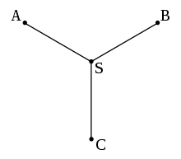
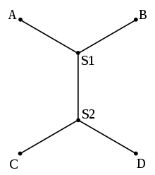
The Steiner tree problem in graphs can be seen as a generalization of two other famous combinatorial optimization problems: the (non-negative) shortest path problem and the minimum spanning tree problem. If a Steiner tree problem in graphs contains exactly two terminals, it reduces to finding a shortest path. If, on the other hand, all vertices are terminals, the Steiner tree problem in graphs is equivalent to the minimum spanning tree. However, while both the non-negative shortest path and the minimum spanning tree problem are solvable in polynomial time, the decision variant of the Steiner tree problem in graphs is NP-complete (which implies that the optimization variant is NP-hard); in fact, the decision variant was among Karp's original 21 NP-complete problems. The Steiner tree problem in graphs has applications in circuit layout or network design. However, practical applications usually require variations, giving rise to a multitude of Steiner tree problem variants.
Most versions of the Steiner tree problem are NP-hard, but some restricted cases can be solved in polynomial time. Despite the pessimistic worst-case complexity, several Steiner tree problem variants, including the Steiner tree problem in graphs and the rectilinear Steiner tree problem, can be solved efficiently in practice, even for large-scale real-world problems.

Slide 4
PROPERTIES OF MINIMUM STEINER TREES
Given a graph and a subset of vertices in the graph, a Steiner tree spans through the given subset.
The Steiner Tree may contain some vertices which are not in given subset but are used to connect the vertices of subset.
The Steiner Tree Problem is to find the minimum cost Steiner Tree.
If given subset (or terminal) vertices is equal to set of all vertices in Steiner Tree problem, then the problem becomes Minimum Spanning Tree problem. And if the given subset contains only two vertices, then it shortest path problem between two vertices.
Minimum Steiner Tree problem is NP Hard.
Exactly three edges at every Steiner vertex.
The angles between the edges meeting at a Steiner vertex is 120 degrees.
If there are N vertices then we can use a maximum of N-2 Steiner vertices.

Slide 5
Shortest Path Based Approximate Algorithm To Solve Steiner Tree Problem
Since Steiner Tree problem is NP-Hard, there are no polynomial time solutions that always give optimal cost. Therefore, there are approximate algorithms to solve the same. Below is one simple approximate algorithm.
Start with a subtree T consisting of one given terminal vertex
While T does not span all terminals
Select a terminal x not in T that is closest to a vertex in T.
Add to T the shortest path that connects x with T
The above algorithm is (2-2/n) approximate, i.e., it guarantees that solution produced by this algorithm is not more than this ratio of optimized solution for a given graph with n vertices. There are better algorithms also that provide better ratio.

Slide 6
MINIMUM SPANNING TREE VS MINIMUM STEINER TREE
Minimum Spanning Tree is a minimum weight tree that spans through all vertices whereas Steiner tree spans through a given subset of vertices.
Finding out Minimum Spanning Tree is polynomial time solvable, but Minimum Steiner Tree problem is NP Hard and related decision problem is NP-Complete.
Spanning trees are just used to remove broadcast loops while Steiner trees ensure smallest common path by adding Steiner vertices.

Slide 8
STEINER RATIO
For a given variant of the Steiner tree problem, Steiner ratio is the maximum possible ratio of the length of a minimum spanning tree of a set of terminals to the length of an optimal Steiner tree of the same set of terminals.
It is usually written ρ (rho).

Slide 9
Well-known variants of minimum Steiner trees
Euclidean Steiner tree
Rectilinear Steiner tree
Steiner tree in graphs and variants
k-edge-connected Steiner network problem
k-vertex-connected Steiner network problem

Slide 10
EUCLIDEAN STEINER TREE
Given N points in the plane, the goal is to connect them by lines of minimum total length in such a way that any two points may be interconnected by line segments either directly or via other points and line segments. It may be shown that the connecting line segments do not intersect each other except at the endpoints and form a tree.
The problem for N = 3 has long been considered, and quickly extended to the problem of finding a star network with a single hub connecting to all of the N given points, of minimum total length

Slide 11
RECTILINEAR STEINER TREE
The rectilinear Steiner tree problem is a variant of the geometric Steiner tree problem in the plane, in which the Euclidean distance is replaced with the rectilinear distance. The problem arises in the physical design of electronic design automation. In VLSI circuits, wire routing is carried out by wires that are often constrained by design rules to run only in vertical and horizontal directions, so the rectilinear Steiner tree problem can be used to model the routing of nets with more than two terminals

Slide 12
APPLICATIONS OF STEINER TREE
Any scenario where the task is to minimize cost of connection among some important locations like
Modelling of Biomolecular Structures
VLSI Design
Computer Networks, etc.

Slide 13
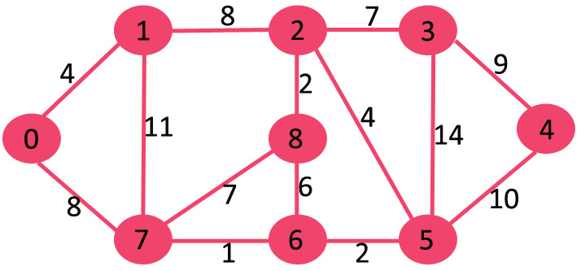
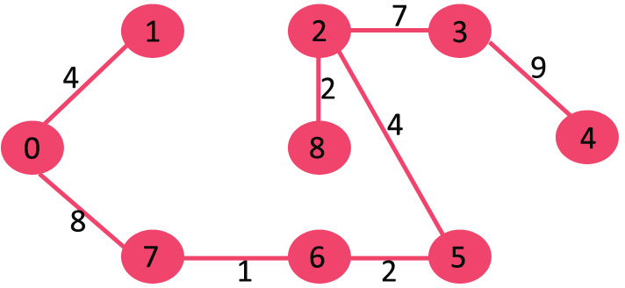
KRUSKAL’S ALGORITHM
1. Sort all the edges in non-decreasing order of their weight.
2. Pick the smallest edge. Check if it forms a cycle with the spanning tree formed so far. If cycle is not formed, include this edge. Else, discard it.
3. Repeat step#2 until there are (V-1) edges in the spanning tree.

Slide 14
PSEUDU CODE
MST- KRUSKAL(G):
1 A = ∅
2 foreach v ∈ G.V:
3 MAKE-SET(v)
4 foreach (u, v) in G.E ordered by weight(u, v), increasing:
5 If FIND-SET(u) ≠ FIND-SET(v):
6 A = A ∪ {(u, v)}
7 UNION(u, v)
8 return A
O(1)
2,3. A Very Slowly Growing Function O(ElogE) or
4. O(E log (E)) O(ElogV)
5,6,7,8. O(E log(V))

Slide 15
Kruskal’s Algorithm for a Big Graph(more Vertices)

Slide 16
PRIM’S ALGORITHM
1) Create a set mstSet that keeps track of vertices already included in MST.
2) Assign a key value to all vertices in the input graph. Initialize all key values as INFINITE. Assign key value as 0 for the first vertex so that it is picked first.
3) While mstSet doesn’t include all vertices ….a) Pick a vertex u which is not there in mstSet and has minimum key value. ….b) Include u to mstSet. ….c) Update key value of all adjacent vertices of u. To update the key values, iterate through all adjacent vertices. For every adjacent vertex v, if weight of edge u-v is less than the previous key value of v, update the key value as weight of u-v

Slide 17
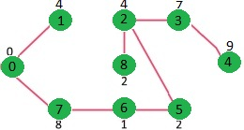
EXAMPLE

Slide 18

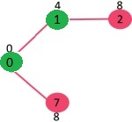
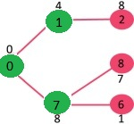
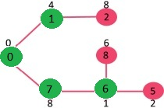
STEPS IN BETWEEN

Slide 19
HOW IT WORKS(DEMO)

Slide 20
TIME COMPLEXITY
The complexity of prim’s is O(V^2) if Adjacency matrix is used.
If Adjacency list is used then O(Elog(V)).

Slide 21


